Slide 1
RISC and CISC Architecture

Slide 2
Introduction :
Instruction set architecture is a part of processor architecture, which is necessary for creating machine level programs to perform any mathematical or logical operations.
The performance of the processor is defined by the instruction set architecture designed in it. The two major instruction sets architectures are
1) CISC (Complex Instruction Set Computing)
2) RISC (Reduced Instruction Set Computing)

Slide 3
What is RISC?
A reduced instruction set computer is a computer that only uses simple commands and executes within a single clock cycle, as its name proposes “Reduced Instruction Set”.
The RISC is a Reduced Instruction Set Computer microprocessor and its architecture includes a set of instructions that are highly customized.

Slide 4
What is RISC?
The kind of processor is mainly used to execute several difficult commands by merging them into simpler ones.
RISC processor needs a number of transistors to design and it reduces the instruction time for execution.
Examples of RISC processors
alpha, AVR, ARM, PIC, PA-RISC, Intel i860,SPARC,MIPS R3000,IBM RS/6000.

Slide 5
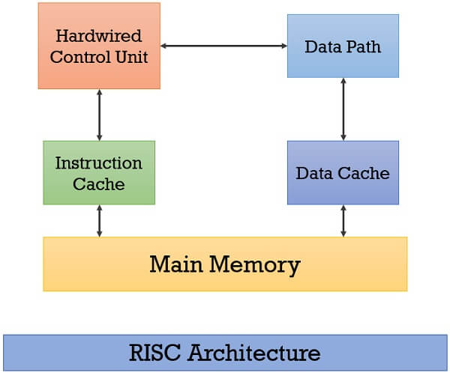

Slide 6
RISC Architecture
The term RISC stands for ‘’Reduced Instruction Set Computer’’. It is a CPU design plan based on simple orders and acts fast.
In RISC architecture, the instruction set of processor is simplified to reduce the execution time. It uses small and highly optimized set of instructions which are generally register to register operations.

Slide 7
RISC Architecture
Each instruction is of a similar length; these are wound together to get compound tasks done in a single operation.
Most commands are completed in one machine cycle. This pipelining is a crucial technique used to speed up RISC machines.

Slide 8
Characteristics of RISC Processor :
Efficient Pipeline architecture.
The number of instructions are restricted.
The instructions like load as well as store have right of entry to memory.
Addressing modes are less.
It consists of relatively few Instructions (<50).
It consists of Fixed –length Instruction Format and easily decoded Instruction Format.

Slide 9
Characteristics of RISC Processor :
RISC Processor consists of mostly Register-to-Register Operations.
RISC Processor contains Hardwired control Unit rather than Micro programmed control Unit.
Complexity is in the Compiler.
Very few instructions refer Memory.
It consists of Multiple Register set.
An average CPI is less than 1.5 in RISC Processor.

Slide 10
Advantages of RISC Architecture :
The performance of this processor is good because of the easy & limited no. of the instruction set.
This processor uses several transistors in the design so that making is cheaper.
The execution of instructions in RISC processors is high due to the use of many registers for holding and passing the instructions as compared to CISC processors.
It is very simple as compared with another processor due to this; it can finish its task within a single clock cycle.

Slide 11
Disadvantages of RISC Architecture :
The performance of a RISC processor depends on the code that is being executed.
The processor spends much time waiting for first instruction result before it proceeds with next subsequent instruction, when a compiler makes a poor job of scheduling instruction execution.
RISC processors require very fast memory systems to feed various instructions. Typically, a large memory cache is provided on the chip in most RISC based systems.

Slide 12
What is CISC?
It was developed by the Intel Corporation and it is Complex Instruction Set Computer.
This processor includes a huge collection of simple to complex instructions.
These instructions are specified in the level of assembly language level and the execution of these instructions takes more time.

Slide 13
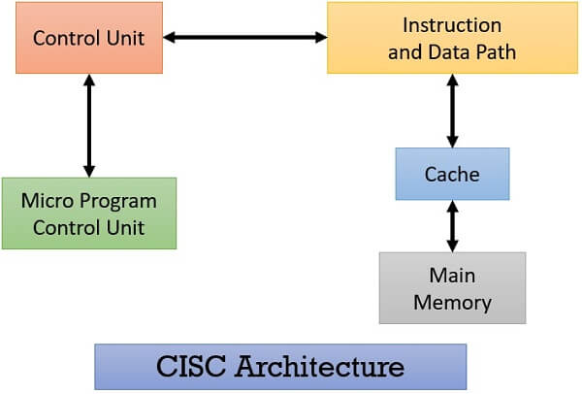

Slide 14
CISC Architecture
The term CISC stands for ‘’Complex Instruction Set Computer’’.
It is a CPU design plan based on single commands, which are skilled in executing multi-step operations.
CISC computers have small programs. It has a huge number of compound instructions, which takes a long time to perform.

Slide 15
CISC Architecture
Here, a single set of instructions is protected in several steps; each instruction set has additional than 250 separate instructions.
Maximum instructions are finished in two to ten machine cycles. In CISC, instruction pipelining is not easily implemented.
Examples of CISC processor
IBM 370/168
Intel 80X86
VAX Computer

Slide 16
Characteristics of CISC :
CISC supports high-level languages for simple compilation and complex data structure.
Variable length Instruction format used by CISC Architecture.
Large number of instructions, typically from 100 to 250 instructions.
A large variety of addressing nodes typically from 5 to 20 different addressing modes.
Not pipelined or less pipelined.
Complexity is in the Microprogram.

Slide 17
Characteristics of CISC :
Complex Instructions take multiple clock cycles to execute. An average CPI is between 2 and 15.
Most of the instructions may refer memory to manipulate operands in memory.
Execution time is more.
Instructions are larger than one word size.
Instructions decoding is complex.
Single Register set is used.

Slide 18
Advantages of CISC
Microprogramming is easy to implement and much less expensive than hard wiring a control unit.
A single instruction can be executed by using different low-level tasks
CISC utilizes less instruction set to execute the same instruction as the RISC.

Slide 19
Disadvantages of CISC
The existing instructions used by the CISC are 20% within a program event.
As compared with the RISC processor, CISC processors are very slow while executing every instruction cycle on every program.
This processor use number of transistors as compared with RISC.
The pipeline execution within the CISC will make it difficult to use.
The machine performance reduces because of the low speed of the clock.

Slide 20
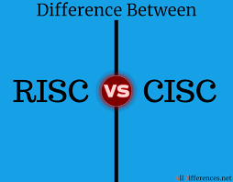

Slide 21
RISC | CISC
Reduced Instruction Set Computer | Complex Instruction Set Computer.
The microprocessor is designed using hardwired control. | The microprocessor is designed using code control
It executes at least one instruction in a cycle | Several cycles may be required to execute one instruction
The instructions have simply fixed formats with few addressing modes. | The instructions have variable formats with several complex addressing modes.
It has several general-purpose resisters and large cache memory. | It has a small number of general-purpose registers
LOAD and STORE instructions are used to access Memory. | It uses all types of instructions.
Instruction Decoding is Simple. | Instruction Decoding is Complex.
Pipeline Implementation is Simple. | Pipeline Implementation is complex.
Hard wired Control. | Micro programmed Control.
CISC architecture is used in low-end applications such as security systems, home automation, etc. | RISC is used in high-end applications like video processing, telecommunications, and image processing.

Slide 22
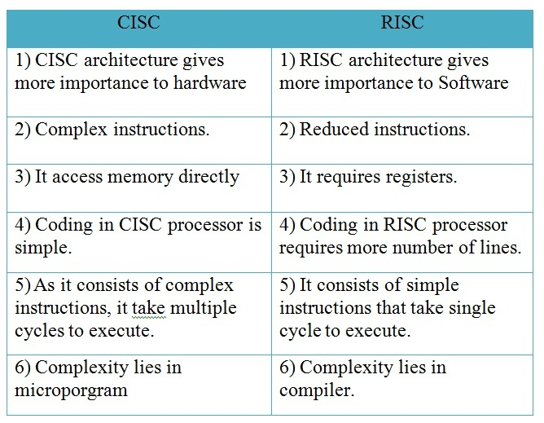

Slide 23


